Slide 1
EV Charging Station Booking System
Submitted by
Sambrekar Utkarsh Raju

Slide 2
1.Existing System
Currently, EV owners face challenges in locating available charging stations and booking them in advance. This often leads to inconvenience and uncertainty, hindering the widespread adoption of electric vehicles.
Due to limited available stations and progress in usage of Electric Vehicles there is time trouble to EV users.
Waiting in queue for charging Vehicles can turn peoples mindset to use fuel consuming cars.

Slide 3
2.Need of System
Enhanced Convenience: Users can plan their charging sessions, reducing waiting times and ensuring their EVs are always ready.
Optimized Resource Utilization: Charging stations can efficiently manage their resources, minimizing idle time and maximizing revenue.
Environmental Impact: Promoting EV adoption contributes to reduced greenhouse gas emissions and air pollution.

Slide 4
3.Proposed System
The proposed EV Charging Station Booking System addresses these challenges by offering a centralized platform.
It allows users to find nearby charging stations, check availability, and reserve a charging slot in advance.
Additionally, the system provides real-time status updates and navigation assistance to the chosen station.

Slide 5
4.Objective of System
Develop a user-friendly platform to facilitate seamless booking of EV charging stations.
Enable users to check real-time availability of charging stations in their vicinity.
Implement a secure authentication system for users to create accounts and manage bookings.
Integrate a geolocation feature to help users locate nearby charging stations easily.
Provide users with information on charging station types, power ratings, and pricing.
Incorporate a payment gateway for secure and convenient transaction processing.
Implement a notification system to alert users about booking confirmations, charging status, and completion.

Slide 6
5.Scope of System
EV Owners: Convenient booking and access to charging stations.
Charging Station Operators: Efficient management of station resources and revenue generation.
Administrators: Comprehensive control over the system, including user management and data analytics.
Future Expansion: The system can integrate additional features like dynamic pricing, predictive maintenance, and integration with smart grids, expanding its capabilities.

Slide 7
6.Module Specification
User Registration and Authentication: Users create accounts and log in securely.
Charging Station Locator: Helps users find nearby charging stations with real-time availability data.
Booking and Reservation: Allows users to book a charging slot at their chosen station.
Payment Integration: Facilitates secure payment for reserved slots.
Navigation Assistance: Integrates with GPS to guide users to the selected charging station.
Admin Dashboard: Offers station owners an interface to manage their station's availability and view analytics.
Customer Support: Enables users to seek assistance and report issues.

Slide 8
5.Operating Environment
Hardware specification:
RAM: 1GB & above
ROM: 512MB & above
Processor: Intel or Ryzen
Software specification:
Windows(OS)
XAMPP

Slide 9
7.Technology Used
Software specification:
Windows(OS)
XAMPP
Frontend: HTML, CSS, JavaScript for the user interface.
Backend: Java, MySQL.
Navigation: Integration with Google Maps API for location services.
Admin Dashboard: Custom-built dashboard using HTML, CSS, js.
Customer Support: In-app chat or ticketing system.

Slide 10
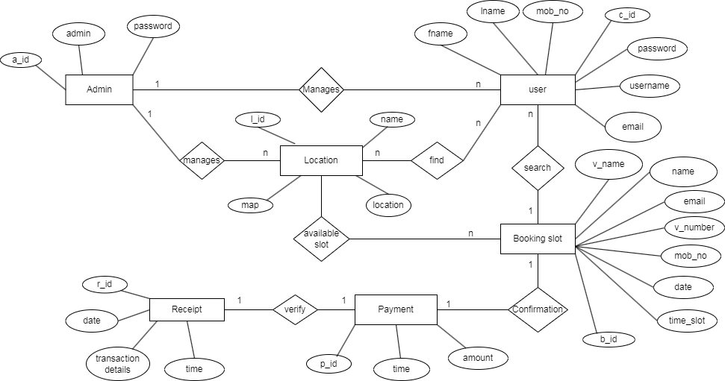
ER Diagram
ANALYSIS AND DESIGN

Slide 11
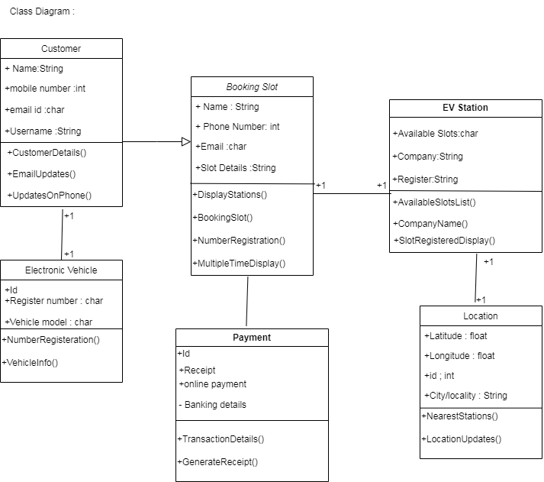
Class Diagram

Slide 12
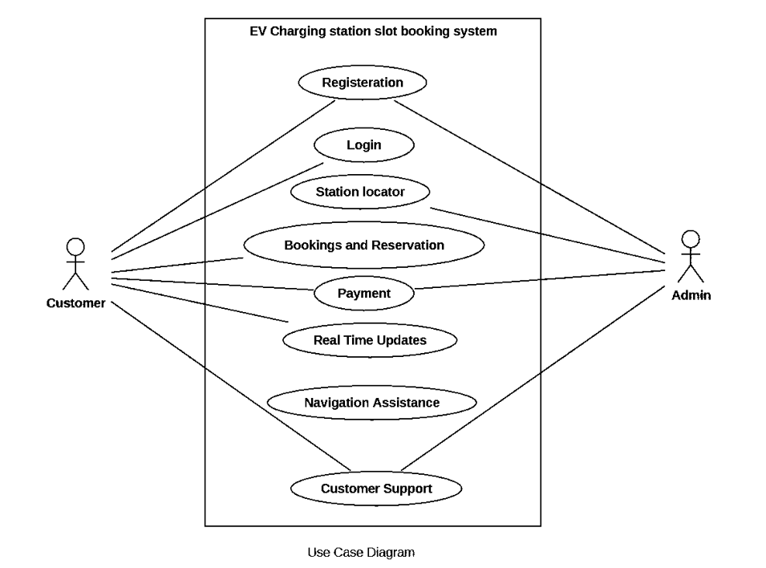
Use Case Diagram

Slide 13
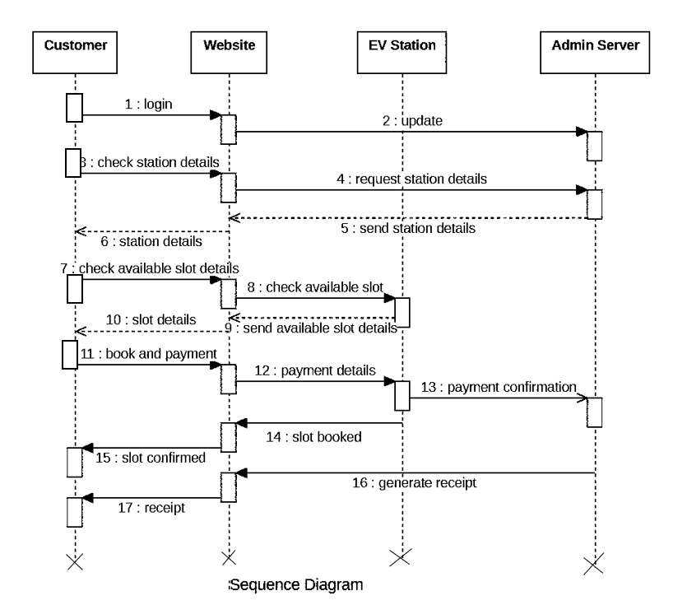
Sequence Diagram

Slide 14
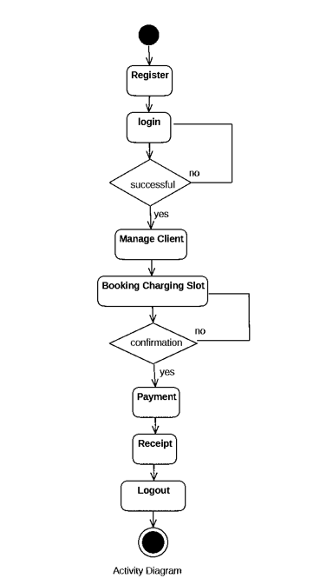
Activity Diagram

Slide 15
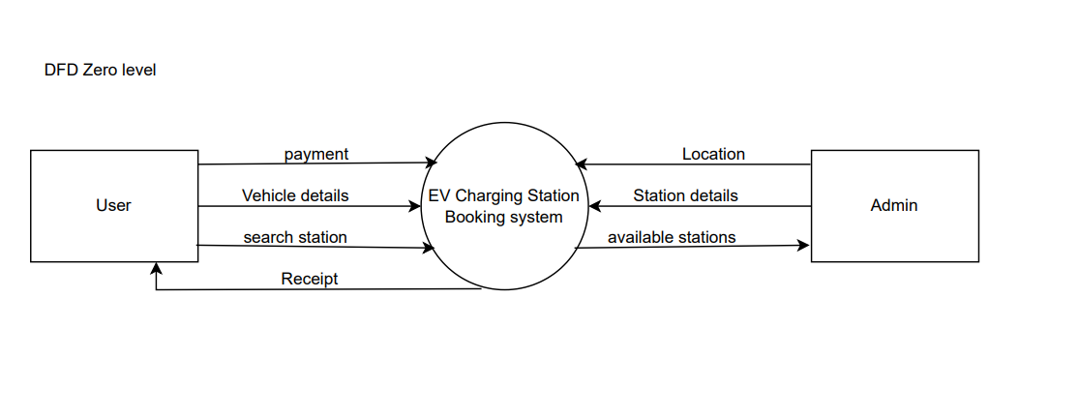
DFD (zeroth level)

Slide 16
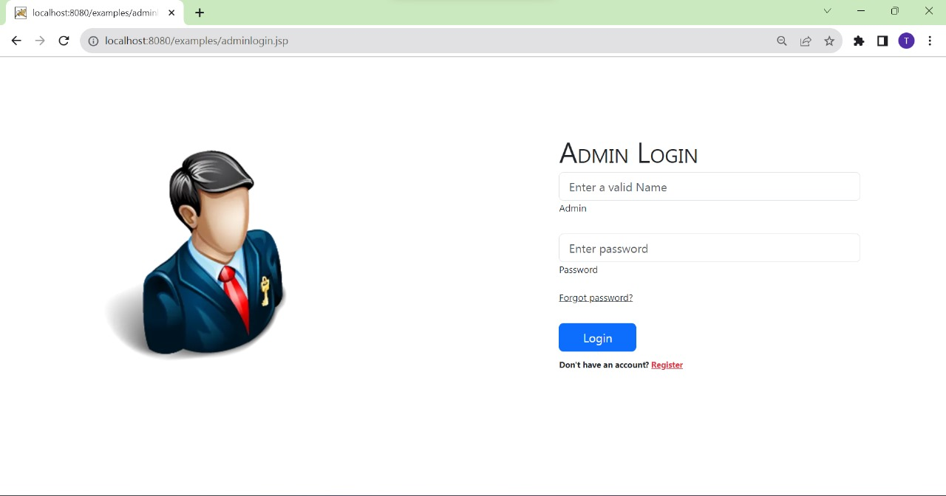
Admin login

Slide 17
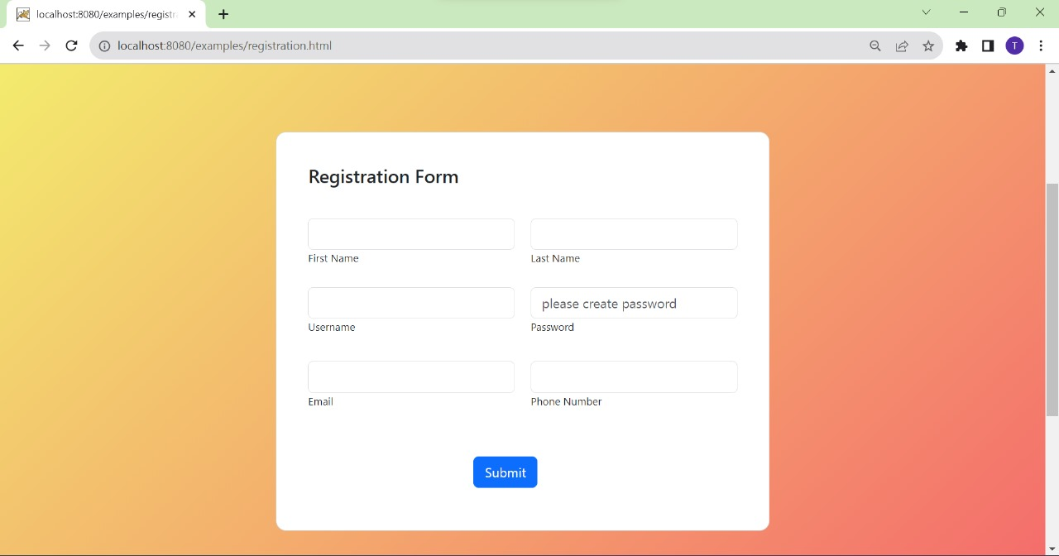
Sign in page

Slide 18
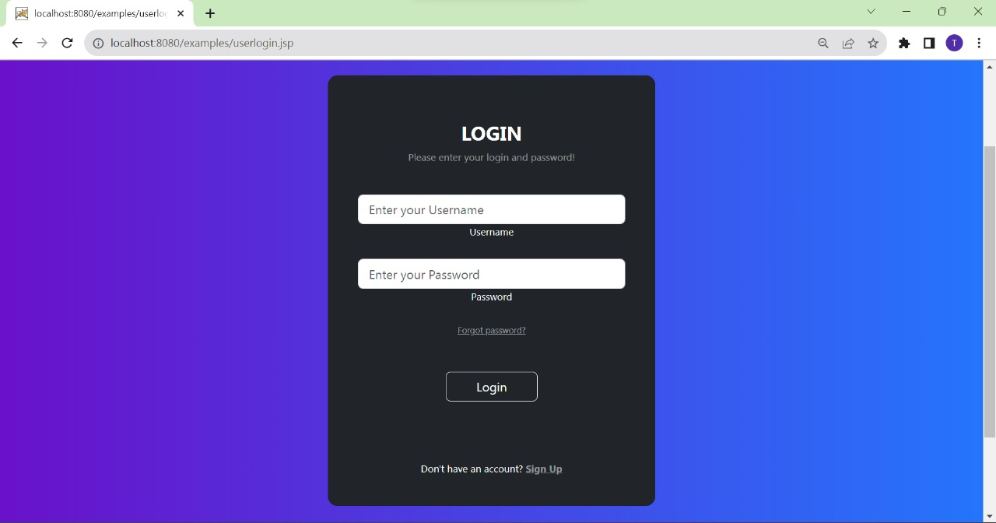
Login Page

Slide 19
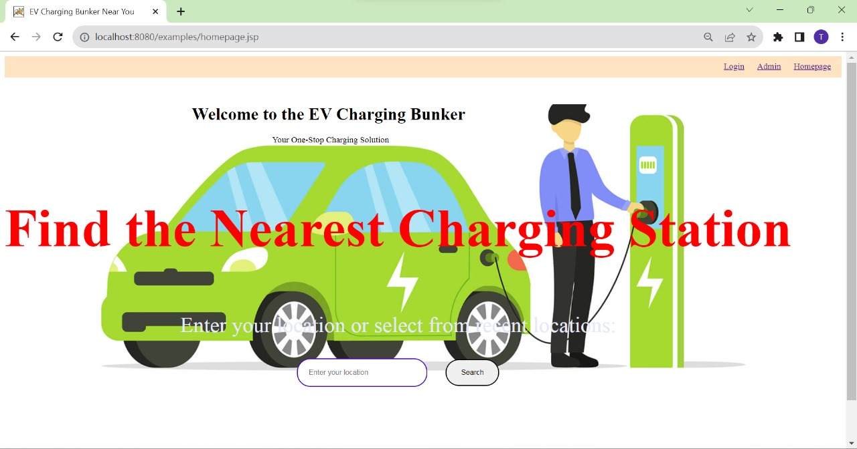
Home Page

Slide 20
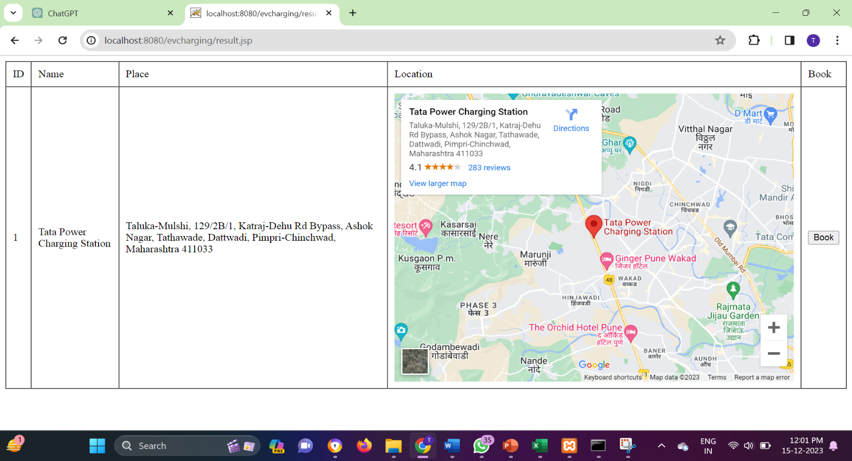
Locations

Slide 21
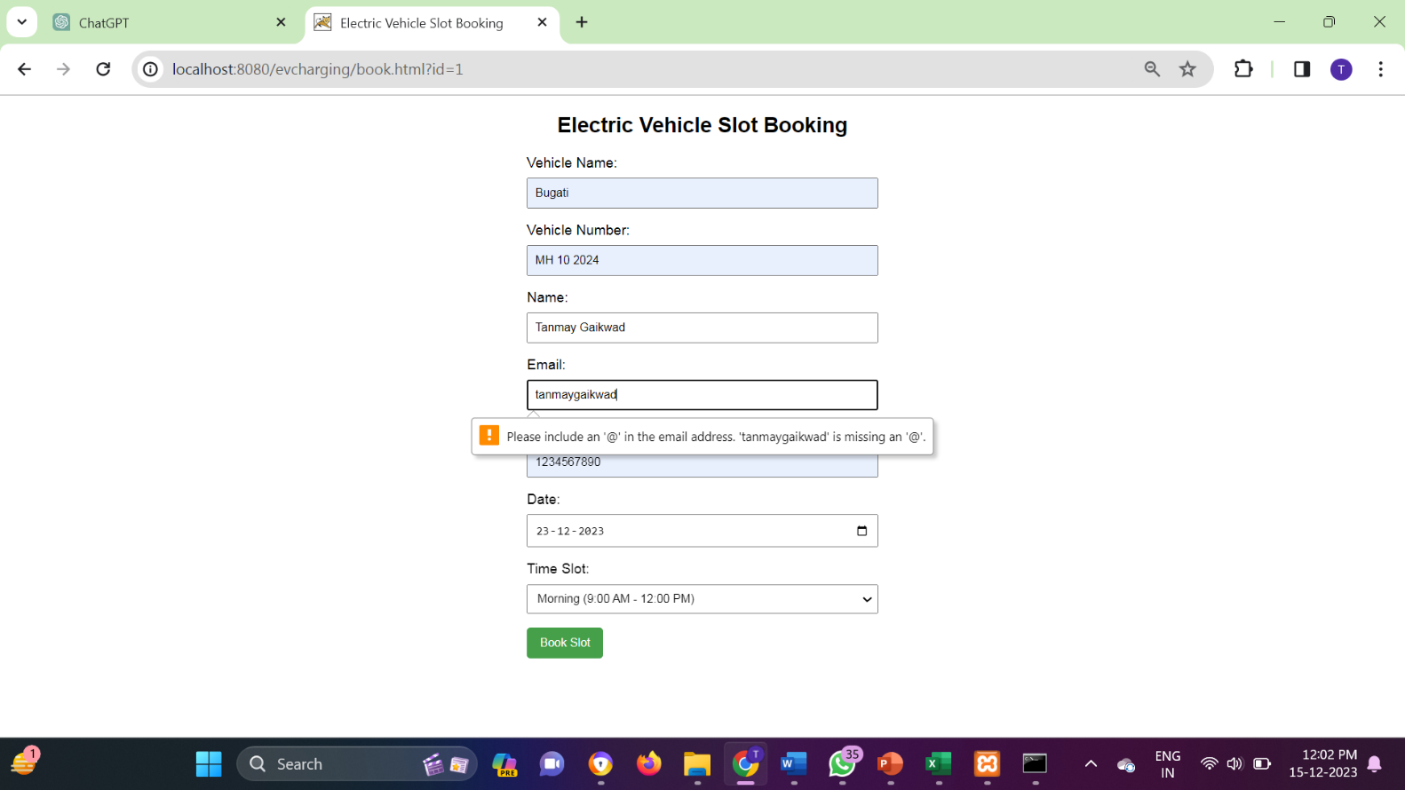
Booking page

Slide 22

Confirmation page

Slide 23
Sign up
Data Dictionary
Fieldname | Fieldtype | size | Description | Constrain
p_id | Int | 20 | Id | Primary Key
p_fname | Varchar | 20 | Firstname | Null
p_lname | Varchar | 20 | Lastname | Null
email | Varchar | 20 | Email | Null
mobile no. | Int | 10 | Mobile Number | Null
password | Varchar | 20 | Password | Null
username | Varchar | 20 | Username | Null

Slide 24
Login
Fieldname | Fieldtype | Size | Description | Constrain
id | int | 20 | Id | Primary key
username | Varchar | 20 | Username | Not Null
password | Varchar | 20 | password | Not Null
Booking Details
Fieldname | Fieldtype | Size | Description | Constrain
b_id | int | 20 | Id | Primary key
arrival time | Varchar | 20 | slot entry time | Not Null
leaving time | Varchar | 20 | slot exit time | Not Null

Slide 25
EV Details
Fieldname | Fieldtype | Size | Description | Constrain
v_id | int | 20 | Id | Primary key
vehicle name | Varchar | 20 | car name | Not Null
register number | Varchar | 20 | register number | Not Null
vehicle type | Varchar | 20 | Vehicle type | Not Null
model | Varchar | 20 | Vehicle Model | Not Null
EV Station
Fieldname | Fieldtype | Size | Description | Constrain
ev_id | int | 20 | Id | Primary key
location | Varchar | 20 | location | Not Null
Name | Varchar | 20 | Name | Not Null

Slide 26
Location
Fieldname | Fieldtype | Size | Description | Constrain
l_id | int | 20 | Id | Primary key
ev_id | int | 20 | ev_id | Foreign key
longitude | double | 20 | longitude | Not Null
latitude | double | 20 | latitude | Not Null
Payment
Fieldname | Fieldtype | Size | Description | Constrain
py_id | int | 20 | id | Primary key
amount | double | 20 | Amount | Not Null
time | time | 20 | time | Not Null

Slide 27
Receipt
Fieldname | Fieldtype | Size | Description | Constrain
r_id | int | 20 | id | Primary key
date | date | 20 | Date | Not Null
amount | double | 20 | Amount | Not Null
time | time | 20 | time | Not Null

Slide 28
Drawback and limitation
Limited Coverage: Availability of charging stations may be limited to specific regions or urban areas, potentially leaving rural or less populated areas underserved.
Dependency on Infrastructure: The effectiveness of the system heavily relies on the existing EV charging infrastructure. In areas with inadequate infrastructure, the system may not provide comprehensive coverage.
Compatibility Issues: Variability in charging standards and protocols among different EV manufacturers could pose challenges for seamless integration, potentially limiting user accessibility.
Reliability on External Factors: System performance may be affected by external factors such as power outages, network disruptions, or maintenance issues with charging stations.
Cost and Affordability: Affordability may be a concern for some users, especially if the charging stations operate on a fee-based model. This can potentially limit access for certain demographics.

Slide 29
Proposed Enhancement
Dynamic Pricing Models: Implement dynamic pricing models that take into account factors such as demand, time of day, and energy availability, encouraging off-peak charging and optimizing station utilization.
Smart Grid Integration: Explore integration with smart grid technologies to enhance energy management, allowing the system to adapt charging rates based on grid demand and renewable energy availability.
Predictive Analytics: Incorporate predictive analytics to anticipate charging station demand, reducing waiting times, and optimizing user experience. Machine learning algorithms can be used to forecast usage patterns.
IoT Sensors for Real-Time Monitoring: Integrate Internet of Things (IoT) sensors to enable real-time monitoring of charging station health, proactively identifying and addressing issues to minimize downtime and improve reliability.
Multi-Modal Integration: Expand the system to support multi-modal transportation planning, integrating with other modes of transportation, such as public transit, ride-sharing, and bike-sharing, for a more comprehensive travel solution.

Slide 30
User Feedback and Rating System: Implement a user feedback and rating system to collect input on charging station experiences. This data can be valuable for continuous improvement and can guide users to reliable and well-maintained stations.
Incentive Programs: Introduce incentive programs, such as loyalty points or discounts, to encourage sustainable charging practices, reward users for using renewable energy, and foster a sense of community among EV users.
Emergency Assistance Integration: Enhance user safety by integrating emergency assistance features, allowing users to request help in case of technical issues or emergencies during the charging process.
Enhanced Mobile App Features: Expand the mobile application with features like real-time traffic information, parking availability, and nearby amenities, providing users with a more comprehensive travel planning experience.
Blockchain for Secure Transactions: Explore blockchain technology to enhance the security of transactions and user data, ensuring a tamper-proof and transparent system for financial transactions and user authentication.
Collaboration with Automakers: Foster collaborations with automakers to integrate the system directly into vehicle interfaces, streamlining the booking process and providing users with real-time charging information while driving.

Slide 31
Thank You

